Slide 1
MARCHING MASTERS
Senior Design 2020-2021
Fall Term Presentation
Notes:
Update with Logo

Slide 2
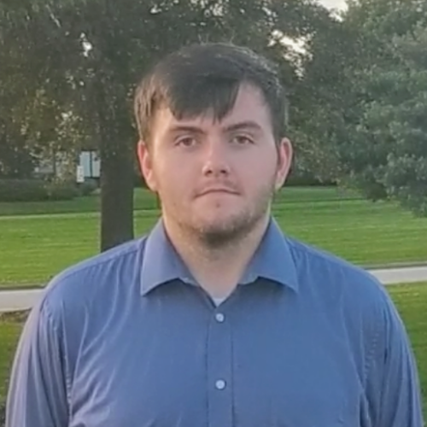
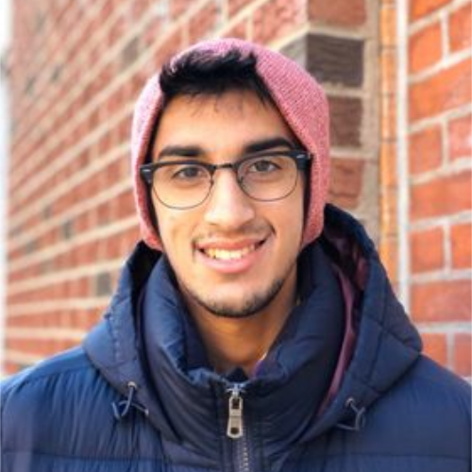
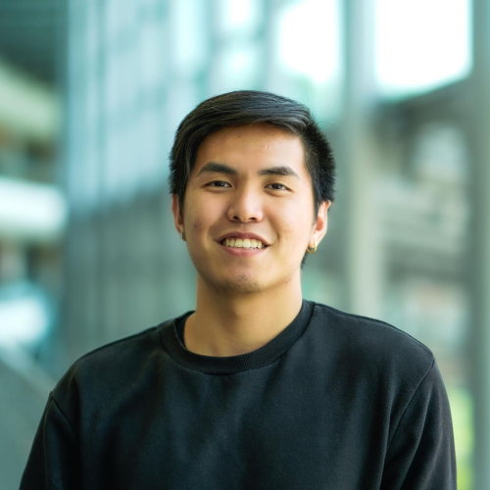

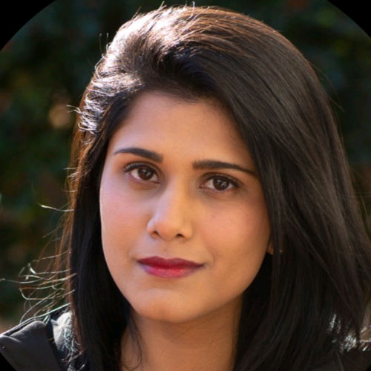
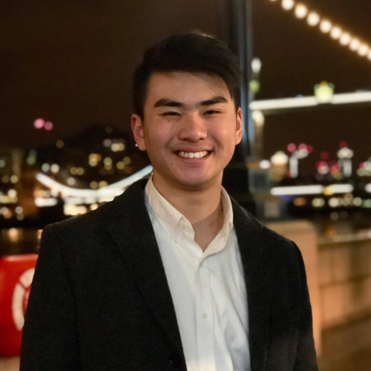
Our Team
Brandin Bulicki
Computer Science Major
System/Software Design Lead
Siddharth Srinivasan
Computer Science Major
Adam Luong
Computer Science Major
Testing Lead
Tumaresi Yalikun
Computer Science Major
Requirements Engineering Lead
Aparna Mishra
Computer Science Major
Project Planning Lead
Jeffer Zhang
Computer Science Major
Software Development Lead

Slide 3
Our Project
Every summer, marching bands and drum corps all around the world learn drill for their season’s performance. Following this, in the winter, indoor percussion, guard, and wind ensembles, prepare their drill for their seasons. As it stands, the only way to effectively learn the coordinates for the show is to go ‘set-by-set’ and check every performer’s positioning for every drill move. Marching Masters aims to improve these outdated methods.
Marching Masters will increase the effectiveness of drill instruction and the proficiency with which a show is performed. Marching Masters will ultimately be the first marching based program that will allow for tracking of the performers from drill set to drill set. This system will allow staff and performers to track the movements of the performers, analyze for correctness against the written drill, and be able to be reviewed by staff and performers. By obtaining this knowledge, staff will be more equipped to provide instruction and performers will be able to further understand what corrections they must make.
Notes:
Marching Masters is a system which will provide a method of measuring a performer’s accuracy during a field performance by comparing the calculated position to the location written advancing the quality of marching arts programs.
Brandin

Slide 4
Features to be Implemented
Functional Features
Application Login Page
Users (Instructor/Performers)
Application Dashboard
Position Tracking
Visualization
Uploading Documents/Events/Assignments
Viewing Documents/Events/Assignments
Send/Receive Feedback
Non-Functional Features
Tracking Speed/Performance
Tracking Accuracy
Notes:
Pull from Customer Requirements

Slide 5
Functional Requirements
Login Page
Registration
Home Screen (Performer & Instructor View)
Field View
Band Information (Performer & Instructor View)
Document Handling
Sending & Viewing Feedback
Settings
Notes:
Pull from SRS
These are just overviews

Slide 6
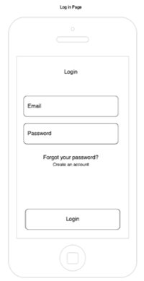
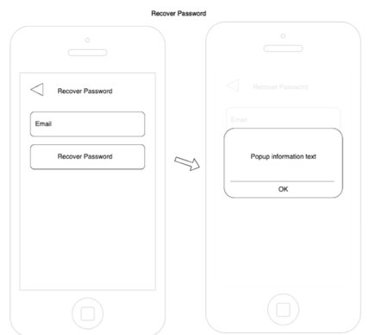
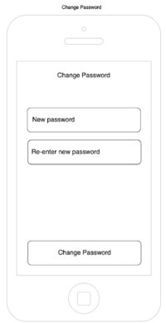
Login Page
Notes:
Tumaris

Slide 7
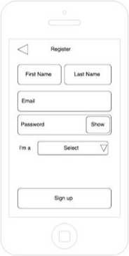
Registration
Notes:
Tumaris

Slide 8
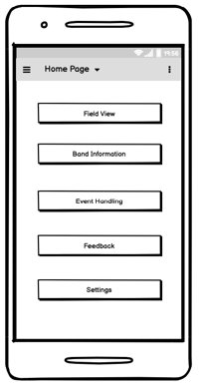
Home Screen
Notes:
Aparna

Slide 9
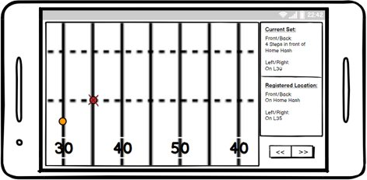
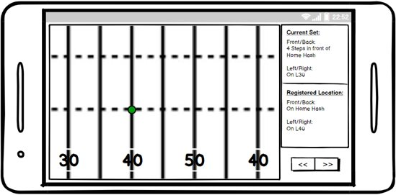
Viewing Field
Notes:
Brandin

Slide 10
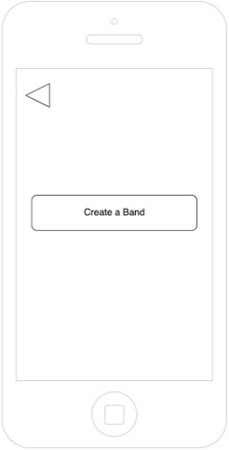
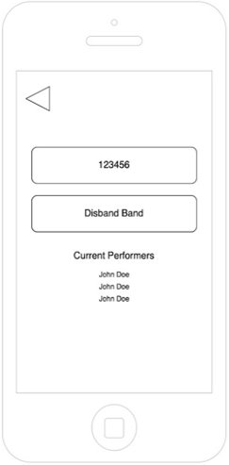
Band Management
Notes:
Jeffer

Slide 11
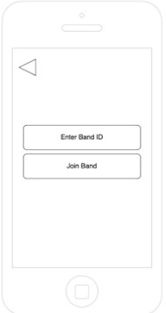
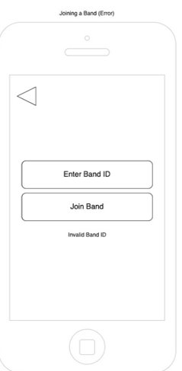
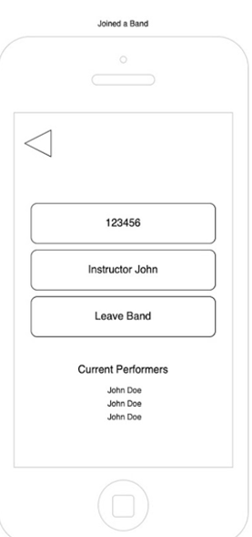
Band Management (Joining)
Notes:
Jeffer

Slide 12
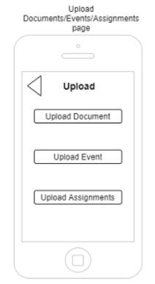
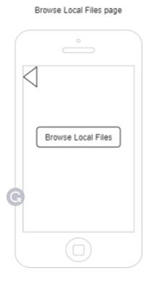
Document/Event Handling (Uploading)
Notes:
Sid

Slide 13
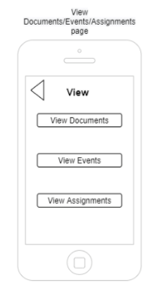
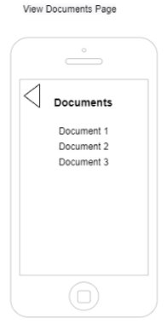
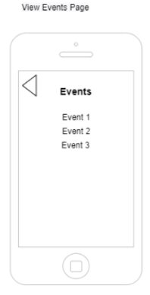
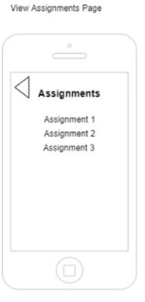
Document/Event Handling (Viewing)
Notes:
Sid

Slide 14
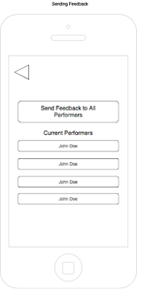
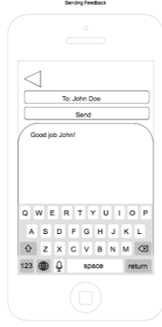
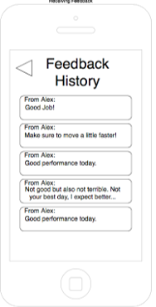
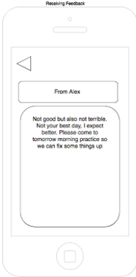
Feedback
Notes:
Adam

Slide 15
Non-Functional Requirements
Tracking Speed (Performance)
Tracking Accuracy
Notes:
Take from SRS & Customer Requirements

Slide 16
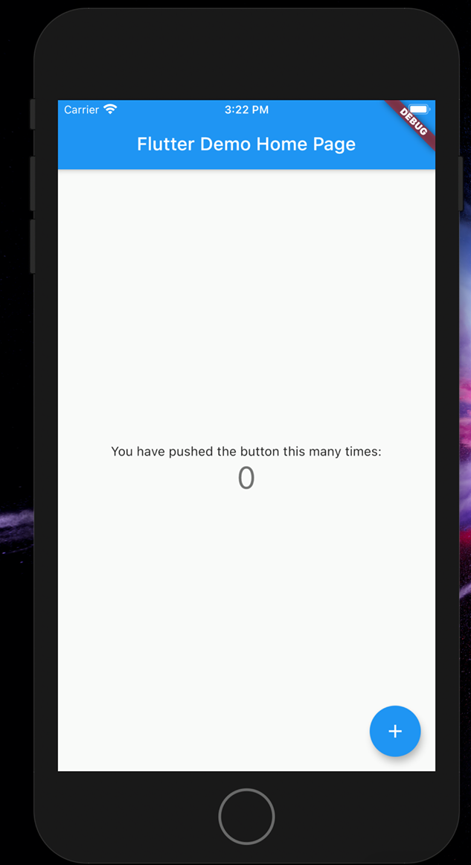
Technical Work Completed
Most of the technical work is still in the early stages of development.
Decisions of technologies were made in order to develop a Proof of Concept and ultimately the full project.
Notes:
Any Development of PoC??
Jeffer – Dart/Flutter

Slide 17
Non-Technical Issues Addressed
Conducted extensive market research to discover the target market.
Organized field studies and performed interviews to understand the user needs.
Notes:
As we are an entrepreneurial project one problem we faced was not realizing the full needs of what our futute potential customers. To combat this we conducted market research. (cont.)
Brandin – Interviews
Aparna – Market Research

Slide 18
Technical Issues Addressed
Decisions were made on the technologies that would be used in both hardware and software.
Hardware: Bluetooth Beacons, IMU Device
Software: Flutter/Dart, Python/Flask, AWS Lambdas
After deciding on a beacon device, we had to change devices due to a change in policy from the original company.
Notes:
Sid – Technologies/PoC

Slide 19
Future Plans
Continue work on Proof-of-Concept design and testing throughout Winter Break.
Design and Develop Marching Masters project next term.
End the term finalizing prototype and beginning testing.
Notes:
Discuss Continuing POC and Future development next term
Brandin

Slide 20
Open Issues
None
Notes:
None

